Slide 1
Open Source
Developer Foundations
Prof. Dr. Dirk Riehle
Friedrich-Alexander University Erlangen-Nürnberg
FOSS C02
Licensed under CC BY 4.0 International
Notes:
It is Friedrich-Alexander University Erlangen-Nürnberg – FAU, in short.
Corporate identity wants us to say “Friedrich-Alexander University”.

Slide 2
Open Source and Innovation
Legal innovation
Process innovation
Software tool innovation
Business model innovation

Slide 3
Evolution of Open Source Projects (Recap)
User consortia
2009
GenIVI Alliance
2005
Kuali Foundation
Single vendor (“commercial”) open source firms
1995
MySQL
2004
SugarCRM, Jaspersoft, Hyperic, ...
Developer foundations
2004 Eclipse Foundation
1999
Apache Software Foundation
2007
Linux Foundation
Distributor firms
1994
Red Hat
2004
Canonical
1992
Suse
2002
Univention
Service and support firms
2011
Hortonworks
1989
Cygnus Solutions
2005
Automattic
2009
MariaDB
Community projects
1987
GCC
1993
Debian
1984
GNU Emacs
1991
Linux kernel
1996
PostgreSQL
2004
CentOS
year
Not a complete history: Events have been chosen for illustration purposes

Slide 4
Open Source “Business Models” (Recap)
Non-profit open source
  Community projects without foundation
  Open source developer foundations
  Open source user foundations
For-profit open source
  Service and support firms
  Open source distributor firms
  Single-vendor open source firms

Slide 5
Open Source Developer Foundations [R10a]
An open source developer foundation is
  a non-profit organization (foundation, consortium)
  with the purpose of managing and performing the development of
  non-differentiating open source software
  made available to foundation members and the general public
Typical members of a developer foundation are
  Software vendors
  Service providers
  Consulting firms

Slide 6
Motivation for Developer Foundations
Support and protect people and their projects
  Protect developers from lawsuits
  Ensure good open source governance
  Legally represent project interests
Create a stronger more competitive ecosystem
  Increase share of customer wallet
  Reach more price-sensitive customers
  Grow addressable market
Create a fair and equal playing field for members
  Regulate access to intellectual property
  Regulate access to marketing channels
  Regulate product roadmap and development

Slide 7
The Apache Software Foundation [A10]
The Apache Software Foundation […] provides an established framework for intellectual property and financial contributions that simultaneously limits contributors potential legal exposure. Through a collaborative and meritocratic development process, Apache projects deliver […] software products […]

Slide 8
Motivation for Developer Foundations 1 / 3
Support and protect people and their projects
  Support and protect people
    Take administrative work off their hands
    Protect developers from lawsuits
  Support and protect projects
    Ensure good open source governance
    Legally represent project interests

Slide 9
Motivation of Developer Foundations 2 / 3
Create a stronger more competitive ecosystem [R07] [R10a]
  Increase share of customer wallet
  Reach more price-sensitive customers
  Grow addressable market

Slide 10
Increase Share of Wallet
(Cost of)
rest of product
components
$$$$
Potential
added revenues
$$
(Cost of)
rest of product
components
$$$$
Money spent on solution
(Cost of)
closed source
component
$$$$
(Cost of) open
source component
$$
Without open source
With open source

Slide 11
Reach More Price-Sensitive Customers
Additional customers
Customer demand curve
Customer demand curve
Money spent on bundled solution
Application
Application
Platform
More customers
More revenue per customer
Open source platform
Number of customers willing to buy

Slide 12
Grow Addressable Market
Total solution market
Total solution market
Ecosystem 1
Ecosystem 2
E 1
Ecosystem 2
Application
$$$$$
Application
$$$$$
A
$$$
Application
$$$$$
Total market size
Platform
Platform
Platform
$$$
$$$
P
$
$$$$$
Two competing platforms
with equal ecosystem size
Dominant platform
with larger ecosystem size

Slide 13
Motivation for Developer Foundations 3 / 3
Create a fair and equal playing field for members
  Regulate access to intellectual property
  Regulate access to marketing channels
  Regulate product roadmap and development

Slide 14
Quiz on Control and Steering Mechanisms
New open source projects can gain users and contributions fast. How can the project creator maintain control and harass users if they wanted to?
  Using IP rights
    Which? How?
  Using position
    Which? How?

Slide 15
Steering and Controlling Open Source [R11a]
Business Goal
Reduce
Development Costs
Maximize
Customer Exposure
Minimize
Competition
Social leadership²
Domain ownership²
Copyright control²
Trademark control²
Development process²
Proprietary
Open Source
Component Type
Social leadership^{1, 2}
Social leadership^{2, 3}
Domain ownership³
Strategic positioning^{2, 3}
Trademark control³
Development process^{2, 3}
Strategic positioning^{2, 3}
Community
Open Source
¹ Closed source firm
² Single-vendor open source firm
³ Open source distributor

Slide 16
Problems and Solutions
(Abuse of) copyright and patents → Solved by license
  A good license contains patent provisions
(Abuse of) trademarks → Solved by foundation
  Foundation clarifies access to and usage rights of trademarks
(Abuse of) social leadership → Can be solved by foundation
  If necessary, the foundation can employ project leaders
(Abuse of) process control → Solved by foundation
  Through by-laws, the foundation can define a proper development process
(Abuse of) other IP rights → Solved by foundation
  Foundation can also own other critical IP rights (e.g. domains)

Slide 17
Advantages over Plain Community Open Source
Clear intellectual property situation
  Clarifies intellectual property situation (trademarks, patents, licenses)
  Helps ensure good open source governance (“IP cleanliness”)
  Allows for proper legal representation in the courts
Improved longevity and survivability
  Makes software people-independent (somewhat, “bus factor”)
  Establishes good corporate governance, collaboration rules
  Increases attractiveness of software ecosystem to developers

Slide 18
Advantages over Traditional Consortia
Established framework
  Increasingly well-understood legal and governance framework
  Increasingly well-understood collaboration behavior
Resulting benefits
  Faster creation at lower cost, less friction, more trust
  More legal and collaboration predictability
  Easier to get skilled developers and firms
Ultimately, higher likelihood of success

Slide 19
Application vs. Platform Developer Foundation
An application developer foundation is
  A developer foundation focused on developing a particular application
  Examples: Wordpress foundation, Drupal foundation, Blender foundation
A platform developer foundation is
  A developer foundation focused on developing a particular platform
  Examples: Linux foundation, Eclipse foundation, Openstack foundation
The difference is one of quantity and quality (for now)

Slide 20

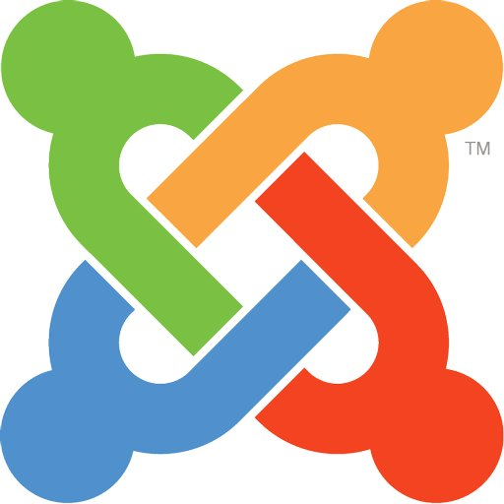











Slide 21
Notes on Application Developer Foundations
Competition breeds strengthening ecosystems
  Wordpress vs. Drupal vs. Joomla! vs. Plone
  KDE vs. Gnome
Some foundations are host to several projects
  Mozilla foundation hosts Firefox, Thunderbird, …
  FSF hosts a garden variety of projects
Some foundations have a broader mission
  Wikimedia hosts Mediawiki but mission is Wikipedia etc.
  Then, perhaps, competitiveness of software suffers

Slide 22
Wordpress Foundation [M10b]
The point of the foundation is to ensure free access, in perpetuity, to the software projects […] As part of this mission, the Foundation will be responsible for protecting the WordPress, WordCamp, and related trademarks. A 501(c)3 non-profit organization […]

Slide 23






Things Can Go Wrong (and Do Go Wrong)

Slide 24
Reasons for Community Fork
TWiki vs FOSWiki
  Struggle over trademarks, foundation, and project leadership
MySQL vs MariaDB
  Struggle over project future and direction
ownCloud vs. Nextcloud
  Struggle over open source philosophy and community

Slide 25
Not all Playing Fields are Created Equal
Automattic owns wordpress.com / wp.com
  Creates strong marketing channel for Wordpress services
Wikimedia Foundation does not have members
  The Mediawiki ecosystem remains unorganized
MariaDB is both a company and project name
  Creates strong marketing channel from .org to .com

Slide 26
Challenges to Building a Partner Ecosystem
Building a closed source partner ecosystem requires
  Trust: Inspiring trust in partners; appearing trustworthy
  Profit: Clearly defining how partners can earn money
  Risk: Believably promise that behavior will not change
Building partner ecosystems is difficult and slow

Slide 27
Creating Partner Ecosystems
Benefits of open source foundation
  Trust: Conduct business in the open
  Profit: Clearly defined rules and regulations
  Risk: Influence through open governance
Ultimately, still a research hypothesis

Slide 28
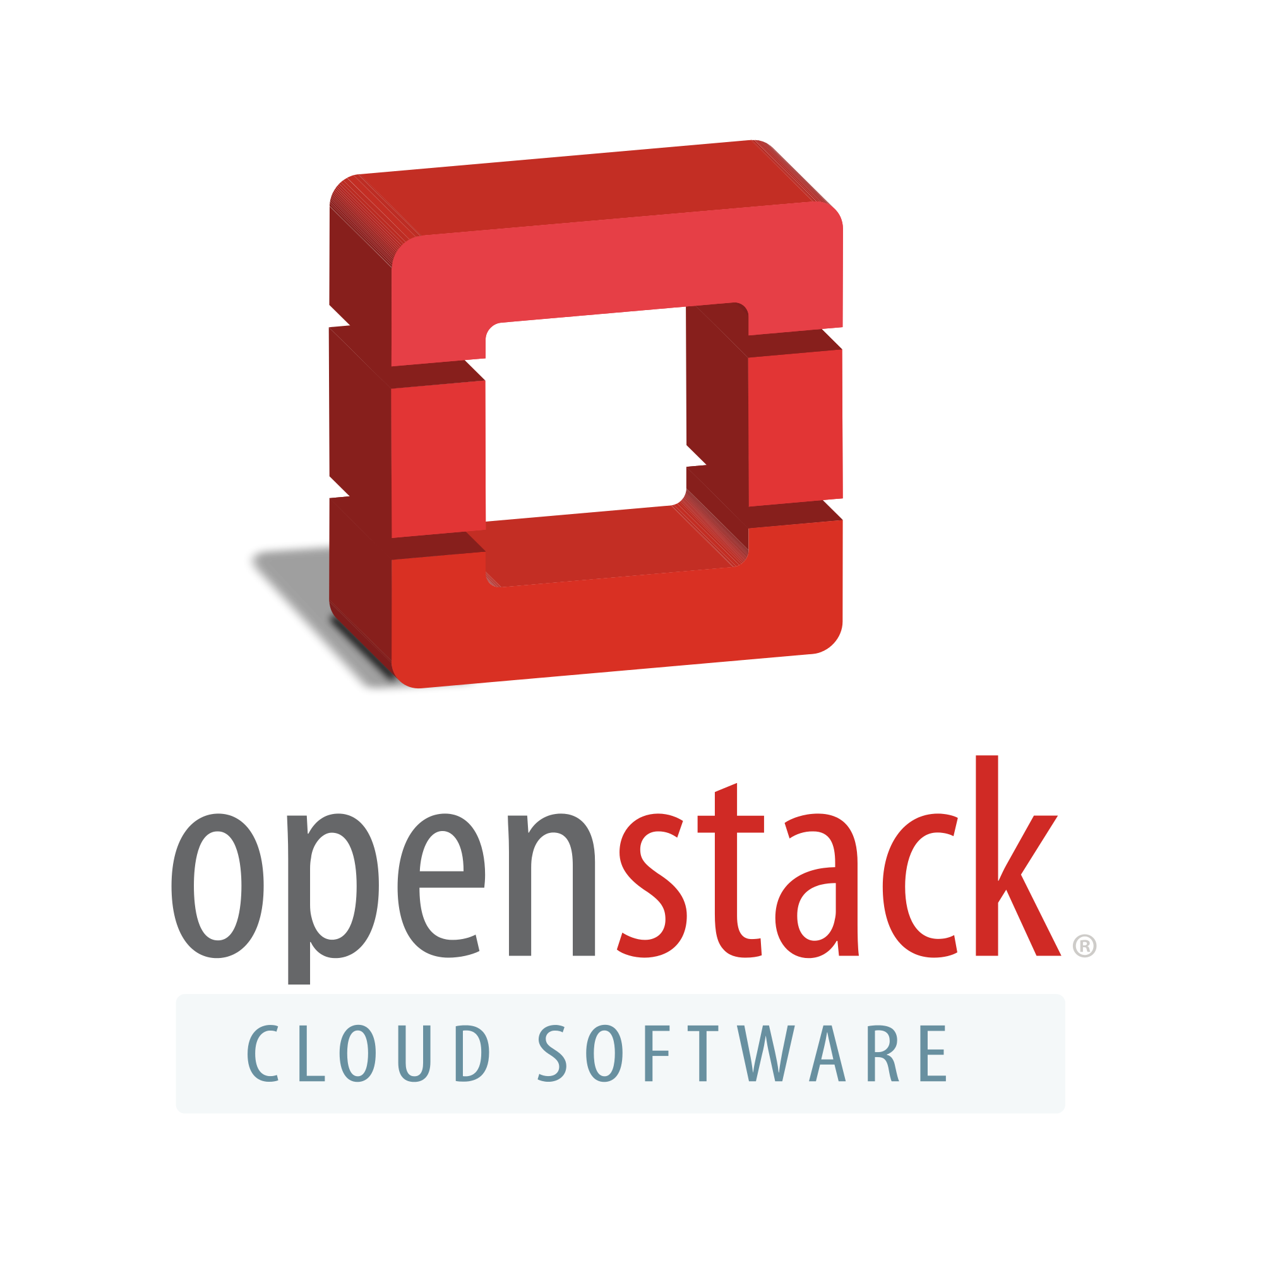











Examples of Platform Developer Foundations

Slide 29
Notes on Platform Developer Foundations
There are less than application developer foundations
  Many of the “foundations” are projects of larger foundations
Still, many projects require their own governance
  The Linux Foundation and Eclipse Foundation are affording this

Slide 30

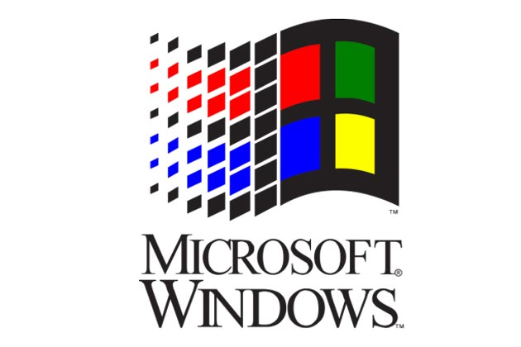

History of The Linux Foundation
1993-current
2000-2007
2007-current

Slide 31









Platinum Members of Linux Foundation [1]
[1] Platinum members pay US$ 500,000 annually (2015)

Slide 32
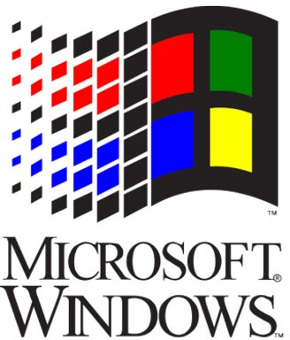


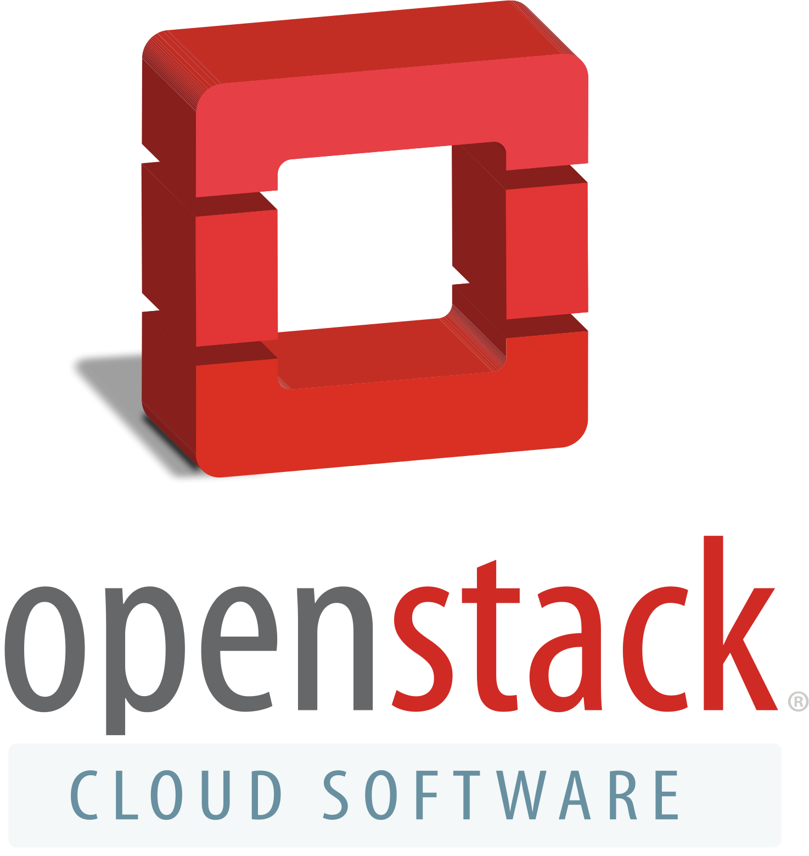
“Ganging Up On The 800lb Gorilla”

Slide 33
Community Software Development
DF
DF delegates to PM
owns
DF delegates to SD
OSS
manages
develops
PM
SD
collaborate
DF = Developer Foundation
PM = Project Management (Committee)
SD = Software Developer (various)

Slide 34
Commercial Product Provision
SU
SU pays for product
owns
SU pays for customization
CP
develops
customizes
SV
CF
partner
SU = Customer
SV = Software Vendor
CF = Consulting Firm

Slide 35
Challenge to Product Management
Company 1
Product A
Company 2
Product B
Company 3
Product C
Company 4
Product D
Proprietary
Open Source
Layers
Community
Open Source
Community
Open Source
Options

Slide 36
Community vs. Code
Community over code
Code over community

Slide 37
Apache Software vs. Eclipse Foundation
Apache Software Foundation
  Purpose
    For public benefit
  Membership
    Only natural persons
  Financing
    Sponsorship
  Project constraints
    Any technology or model
  Project maturation
    Community over code
Eclipse Foundation
  Purpose
    For member benefit
  Membership
    Mostly juristic persons
  Financing
    Member fees
  Project constraints
    Initially, Java only
  Project maturation
    Code over community

Slide 38
Key Aspects of Developer Foundation [R10]
Vision + Mission
Scope / Opportunity
Business Model

Slide 39
Blueprint for Developer Foundations
General
  Purpose
  Incorporation
  Membership
Philosophy
  Open source stance
  Development model
Intellectual property
  Project license
  Patent grant
  IP ownership
Governance
  Board membership
  Project membership
  Member careers
  Member level
Financing
  Foundation
  Projects
Operations
  Infrastructure
  Backoffice

Slide 40
1. General Category
Vision
  Vision of organization
Beneficiaries
  For public benefit
  For member benefit
Incorporation
  No explicit incorporation
  Incorporation, for example, as
    United States: 501(c)3 or 501(c)6
    Germany: e.V. or gGmbH
Membership
  Natural persons
  Juristic persons, for example,
    Software vendors
    Consulting firms
    User firms

Slide 41
2. Philosophy
Exploitation
  Community property
    Implies reciprocal license
  Partial community property
    Implies weak reciprocal license
  Proprietary exploitation
    Implies permissive license
Transparency
  Open project model
  Closed project model, e.g.
    Completeness of artifacts
    Completeness of history
    Availability in time

Slide 42
3. Intellectual Property
Artifact license
  Reciprocal license
  Weak reciprocal license
  Permissive license
Patent handling
  Patent license
  Patent retaliation
Source code
  No copyright transfer
  Contributor agreement
    With copyright transfer
    With relicensing rights grant
Other rights
  Trademarks
  Domains
Warranties
  Required from contributors
  Explicitly none to user

Slide 43
4. Organization Governance
Foundation membership
  Natural member careers
    Career stages, for example,
      User, contributor, committer,
      PMC member, PMC leader, foundation member, board member (Apache)
    Advancement process
      How to advance?
  Juristic member levels
    By type of organization
    By desired influence, for example,
      Associate, solution, enterprise, strategic members (Eclipse)
Board
  Membership
    Who may be a member?
    How to get appointed?
    When to leave; tenure?
  Decision process
    How are decisions made?

Slide 44
5. Project Governance
Project membership
  Project members
    Always natural person, even if they represent a company
  Member roles
    Typically one of
      User, contributor, committer
      PMC member, PMC leader
  Member role acquisition
    Decision making process, for example, committer election
  Member role binding
    Typically tied to natural person, not employer
Software development
  Project agenda
    Defines purpose, scope of project
  Project management
    Defines development process
  Decision process
    Defines how decisions are made
  Project tooling
    Defines development tool setup
  Intervention rights
    Defines board rights to intervene

Slide 45
6. Financing
Financing of organization
  Through members
    Commensurate with level
  Through public grants
  Through sponsorships
  Through for-profit subsidiary
Financing of projects
  Through members
  Through organization funds

Slide 46
7. Operations
Project infrastructure
  Operated by
    Foundation itself
    Foundation members
    On a by-project base
Foundation processes
  Operated by
    Employees
    Volunteers

Slide 47
Dysfunctions of Developer Foundations
Misuse of projects as marketing channels
Abuse of bylaws for ensuring influence

Slide 48
Innovation and Commoditization
Innovation frontier
Commercial +
community distributions
Single-vendor commercial + community
projects
Distributions
Commoditization frontier
Community
distributions
Community
projects
Single products

Slide 49
Review / Summary of Session
Open source developer foundations
  Definition and examples
  Motivation for developer foundations
  Application vs. platform developer foundations
Governance and inner workings
  Challenges to developer foundations

Slide 50
Thank you! Questions?
dirk.riehle@fau.de – http://osr.cs.fau.de
dirk@riehle.org – http://dirkriehle.com – @dirkriehle
DR

Slide 51
Credits and License
Original version
  © 2012-2019 Dirk Riehle, some rights reserved
  Licensed under Creative Commons Attribution 4.0 International License
Contributions
  ...

